Slide 1
GCP Lab
By Altotech

Slide 2
Deploy Node Express APP on GCP

Slide 3
Prerequisite
Node
Npm
Google account
GCP credit (free 300 usd)

Slide 4
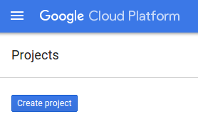
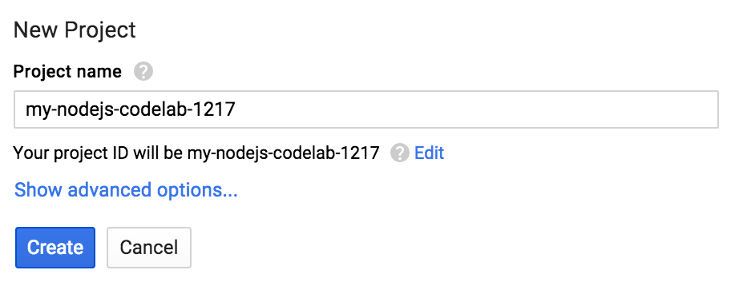
Step 1: Setting it up
Go to
https://console.cloud.google.com
then click Create project

Slide 5
Step 1: Setting it up
you'll need to enable billing in the Developers Console
https://console.developers.google.com/billing
Don’t worry, New users of Google Cloud Platform are eligible for a $300 free trial.

Slide 6

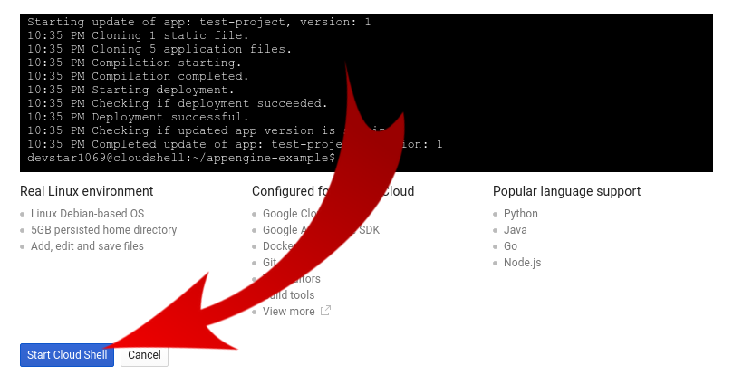
Step 2: Login to the Shell
Click on this icon on the top right corner

Slide 7
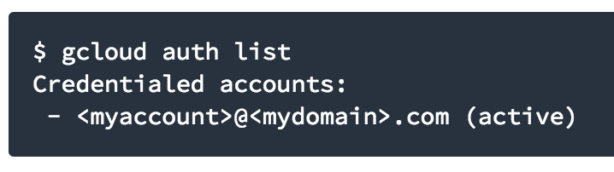
Step 2: Login to the Shell
Type “gcloud auth list”

Slide 8
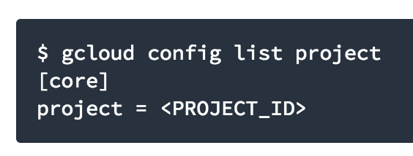
Step 2: Login to the Shell
Type “gcloud config list project” to check the configuration.

Slide 9
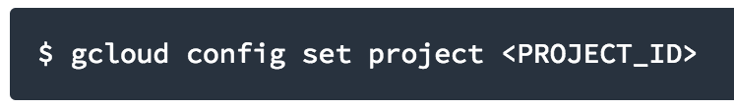
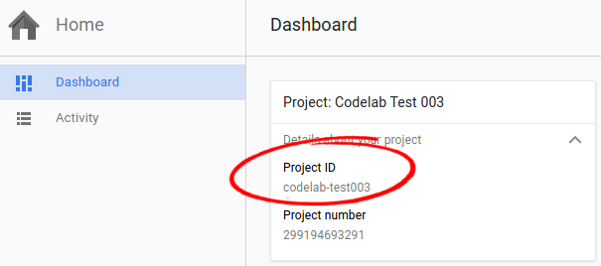
Step 2: Login to the Shell
If for some reason the project is not set, simply issue the following command :

Slide 10
Step 3: Clone the app
Open new tab then login to the https://console.cloud.google.com after that start cloud shell

Slide 11
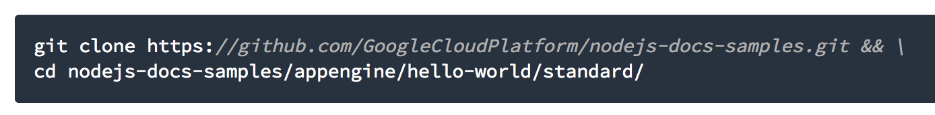
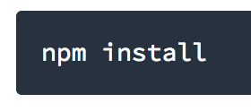
Step 3: Clone the app
Clone the app the run npm install

Slide 12
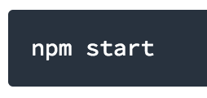
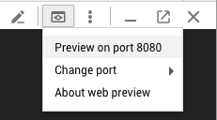
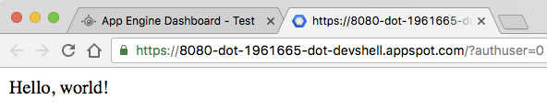
Step 4: Start the app locally

Slide 13
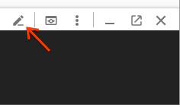
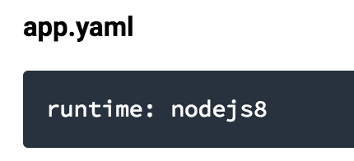
Step 5: Deploy the app

Slide 14
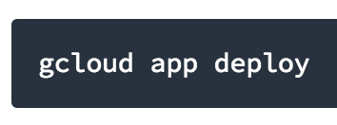
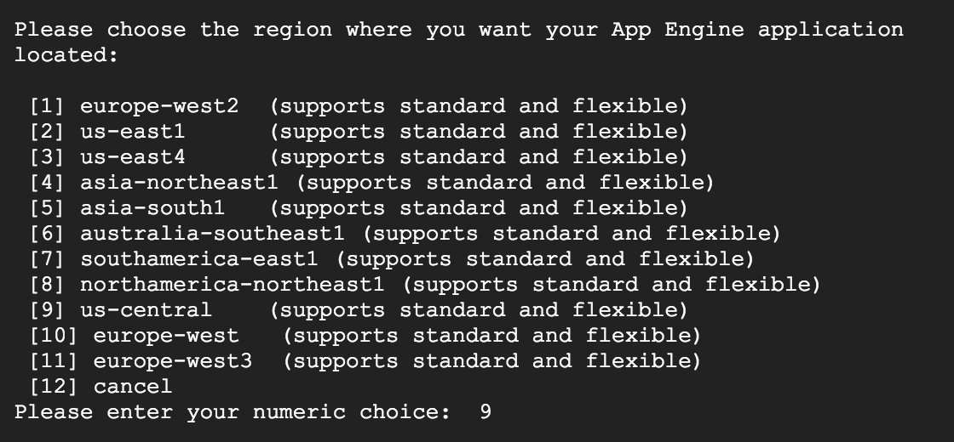
Step 5: Deploy the app

Slide 15
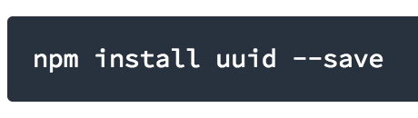
Step 6: Updating Application

Slide 16
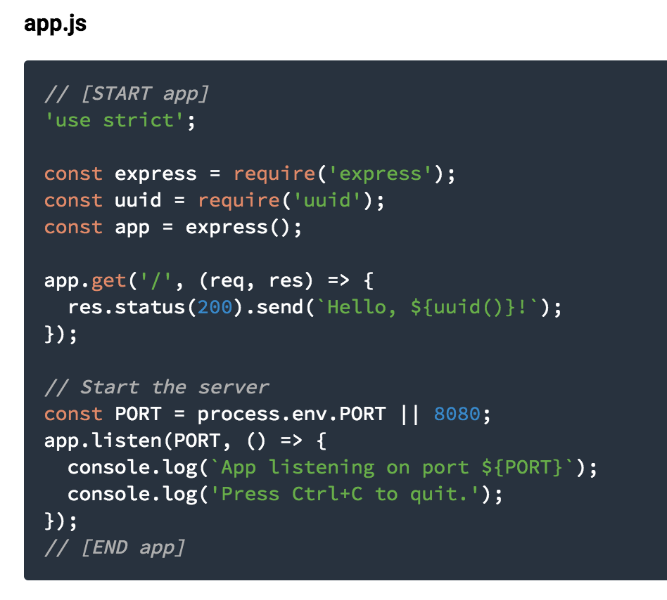

Slide 17
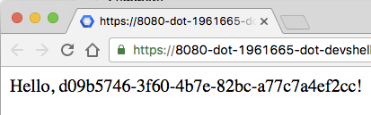
Step 7: Start the app (after editing)

Slide 18
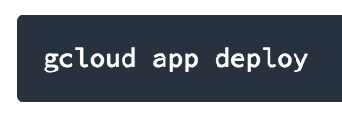
Step 8: Deploy

